Slide 1
Car price prediction
Submitted by:
Priti

Slide 2
Used car price prediction
With the covid 19 impact in the market, we have seen lot of changes in the car market. Now some cars are in demand hence making them costly and some are not in demand hence cheaper. One of our clients works with small traders, who sell used cars. With the change in market due to covid 19 impact, our client is facing problems with their previous car price valuation machine learning models. So, they are looking for new machine learning models from new data. We have to make car price valuation model.

Slide 3
Exercise:
Data Collection Phase
In this section You need to scrape the data of used cars from websites (Olx, cardekho, Cars24 etc.) You need web scraping for this. You have to fetch data for different locations. The number of columns for data doesn’t have limit, it’s up to you and your creativity. Generally, these columns are Brand, model, variant, manufacturing year, driven kilometers, fuel, number of owners, location and at last target variable Price of the car. This data is to give you a hint about important variables in used car model. You can make changes to it, you can add or you can remove some columns, it completely depends on the website from which you are fetching the data.
Model Building Phase
After collecting the data, you need to build a machine learning model. Before model building do all data pre-processing steps. Try different models with different hyper parameters and select the best model. Follow the complete life cycle of data science. Include all the steps like.
1. Data Cleaning
2. Exploratory Data Analysis
3. Data Pre-processing
4. Model Building
5. Model Evaluation
6. Selecting the best model

Slide 4
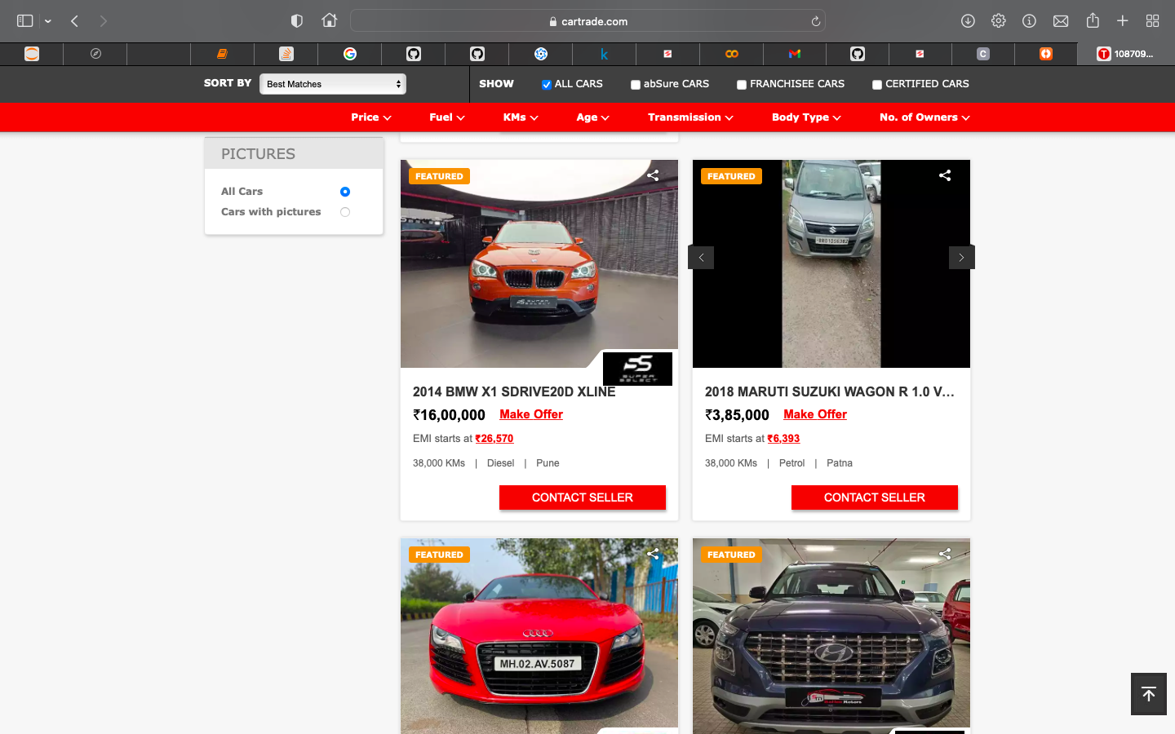
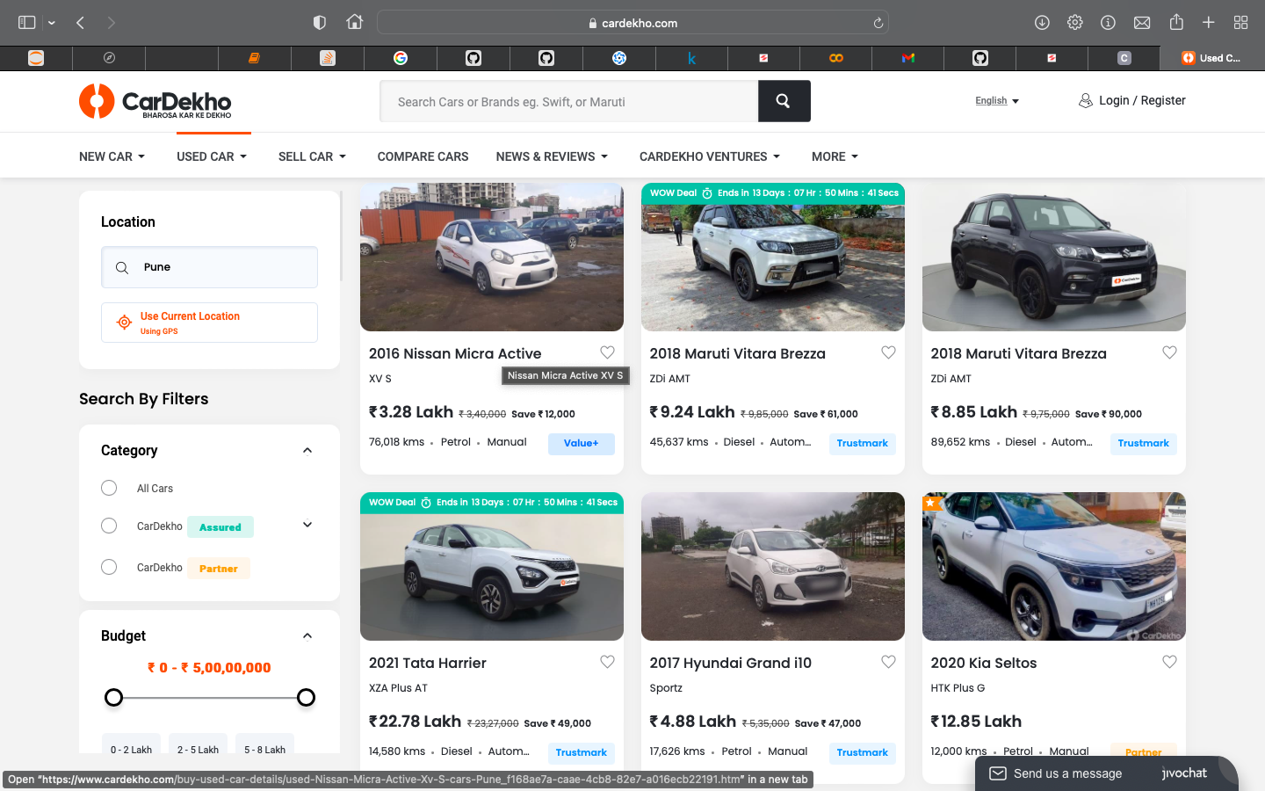
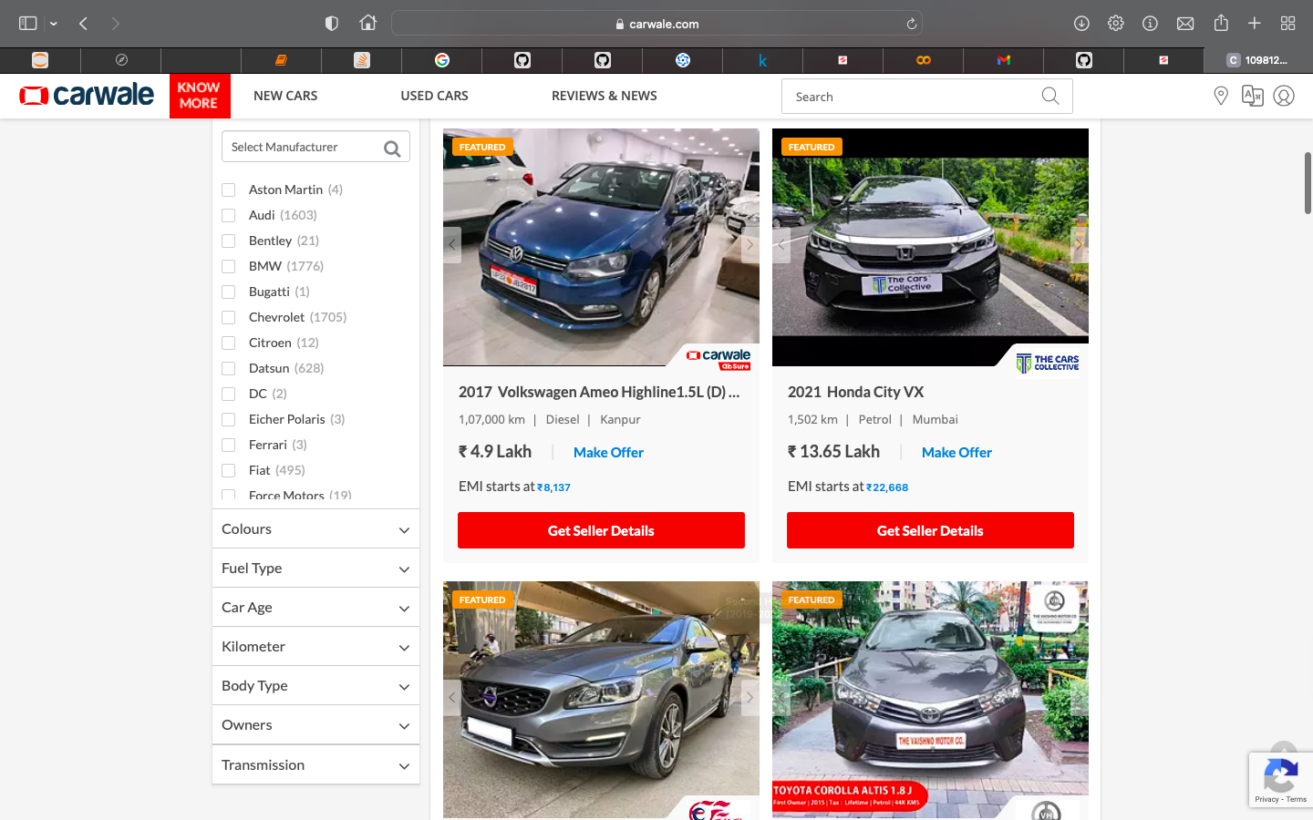
Data Collection Phase
Collected data from different websites such as www.carwale.com, www.cartrade.com, www.cardekho.com

Slide 5
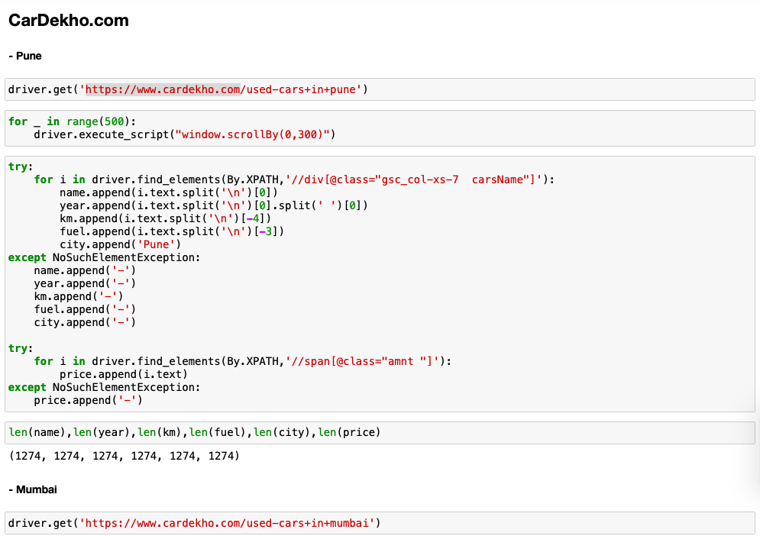
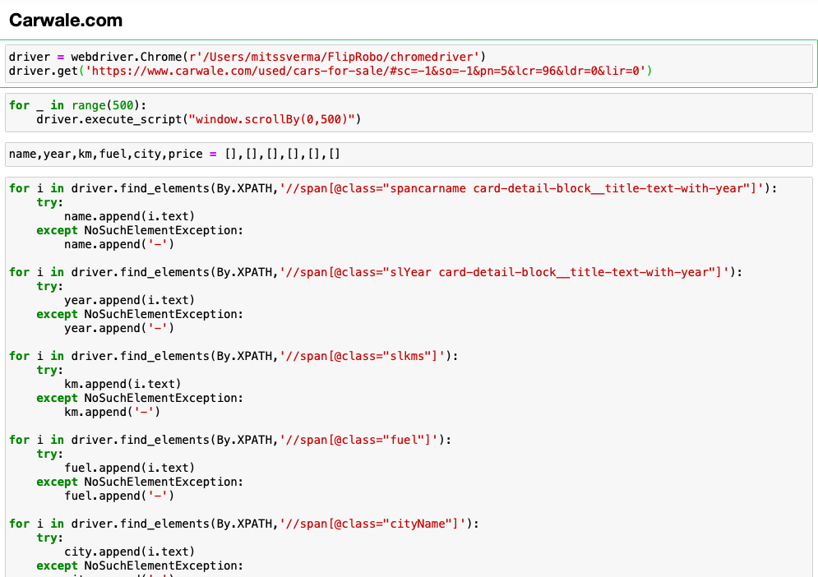
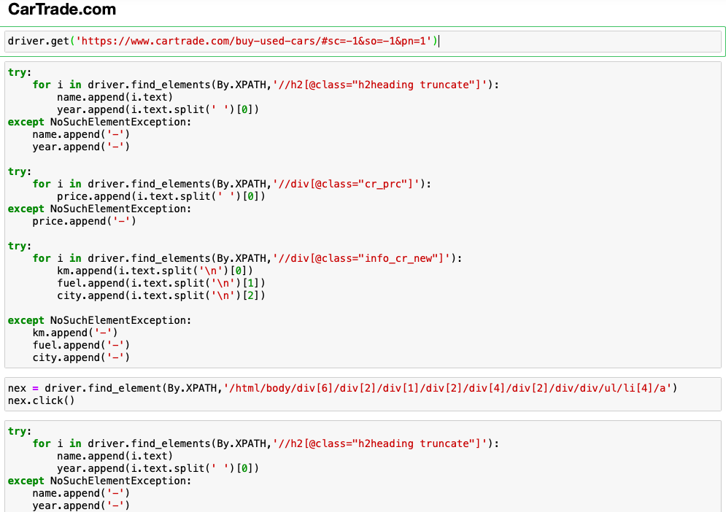
Collected data using Selenium.

Slide 6
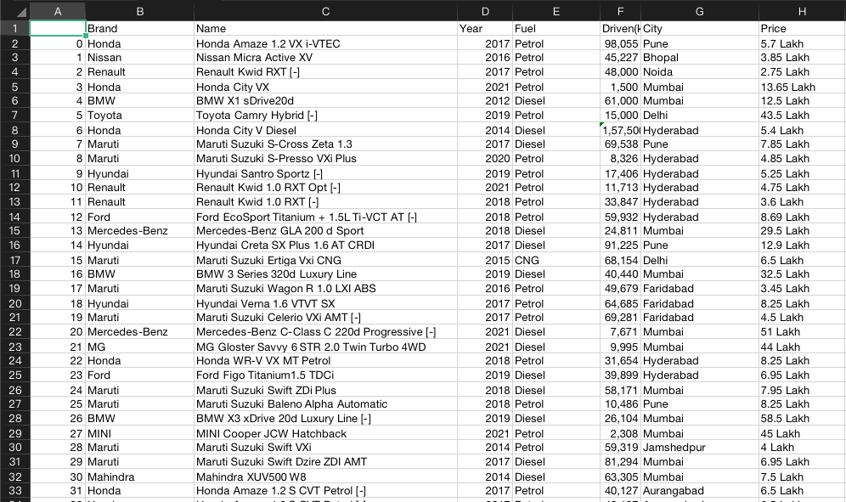
DataFrame/ CSV file
Edited csv file in MS Excel.

Slide 7
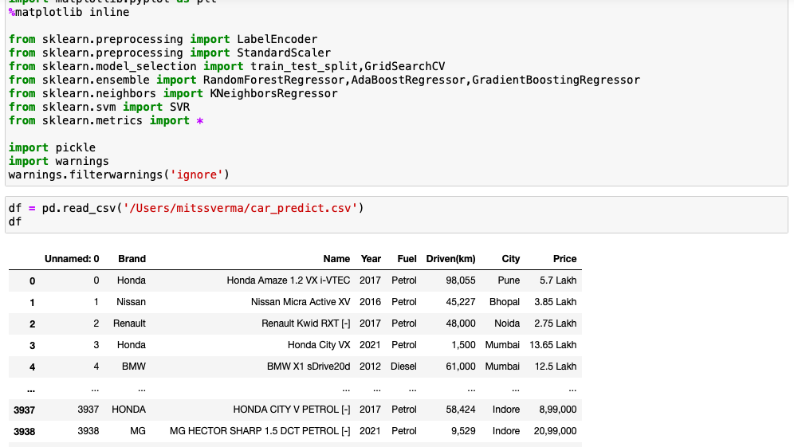
Model Building Phase

Slide 8
EDA:
Shape of first dataset is 3942,8.
Information of the Dataset.
RangeIndex: 0 to 3942
Data columns: 8
dtypes: int64(2), object(6)
Data Cleaning
Converting the price data.
Converting 'Lakh' & 'Cr' in zero's.
Correcting the Driven(km) column.
Converted them from object to int or float.

Slide 9
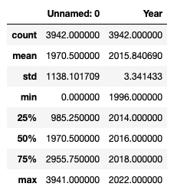
Descriptive Statistic:

Slide 10
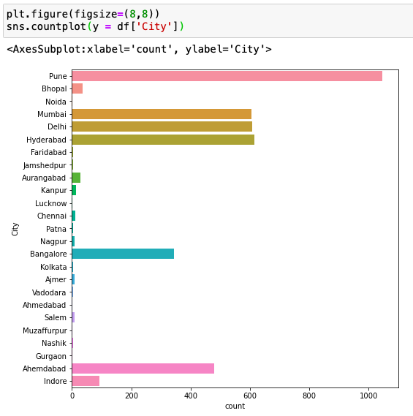
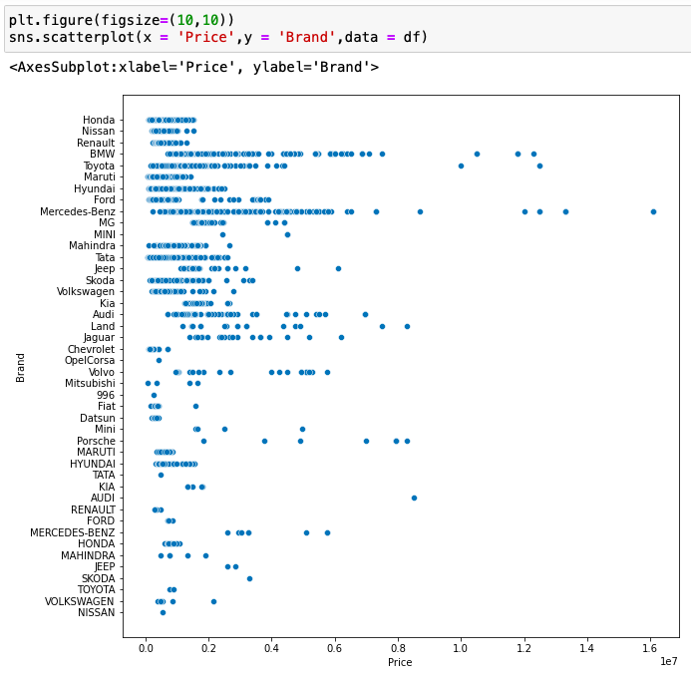
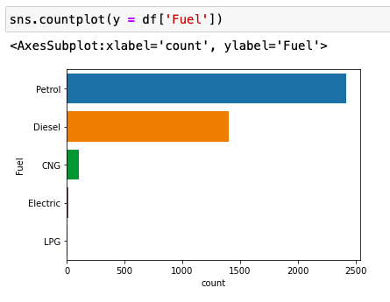
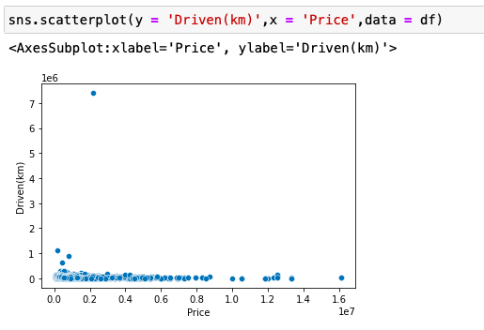
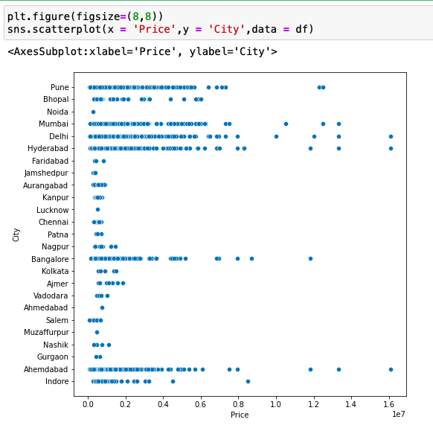
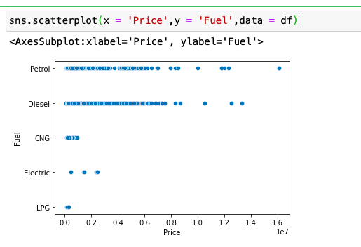
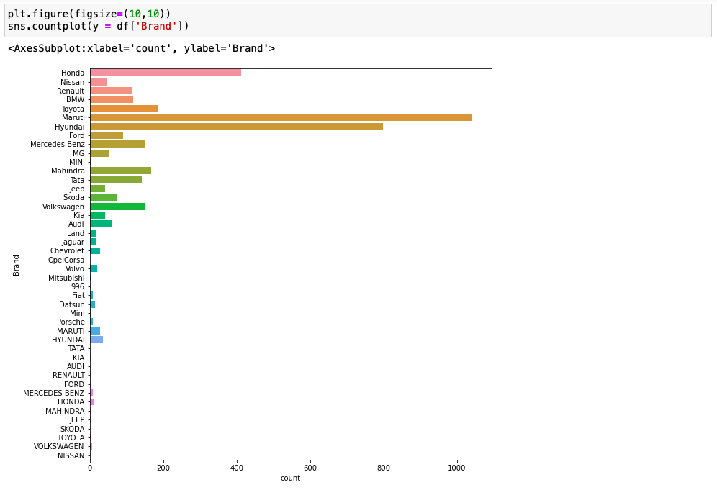
Visualization

Slide 11
Encoding
Columns encoded:
Name.
City.
Brand.
Fuel.

Slide 12
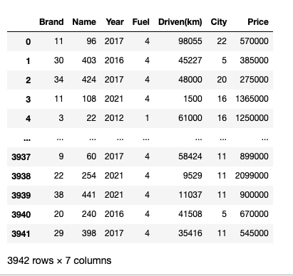
Final Dataset

Slide 13
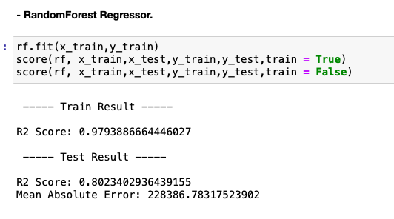
Best Model, Parameters & Score:
RandomForest Classifier.

Slide 14
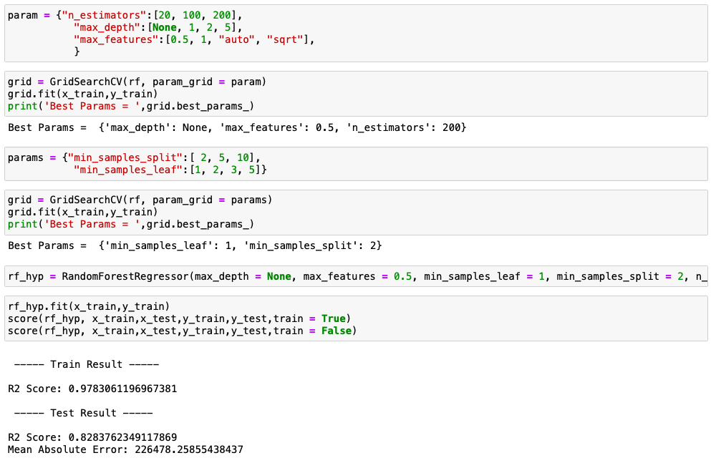
Hyperparameter Tuning & Best parameters.

Slide 15
Conclusion:
From the above project I learn how to scrap the data from different sites and how to use all data for machine learning.
I conclude that random forest regressor is the best model for predicting the car price.
Thank you

